Slide 1
Accounts SDK
What’s under the hood?

Slide 2

Agenda
Welcome
Objectives
Expectations
Themes & Roles
Perspectives

Slide 3
Pre-Requisites
Code is available at: https://github.com/corda/accounts_java_samples/tree/tenancyfeb21

Slide 4
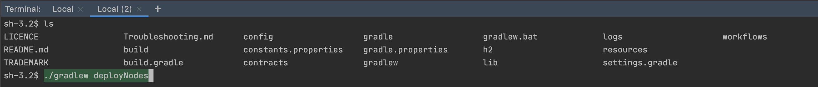
Step 0.1 – build the project
Notes:
Run: ./gradlew deployNodes

Slide 5
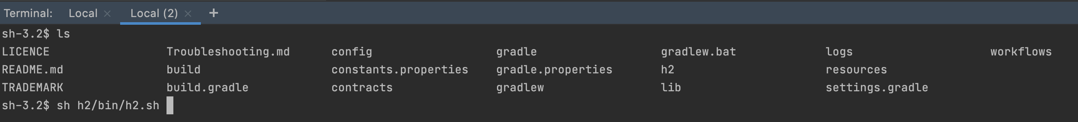
Step 0.2 – start h2 database viewer
Notes:
Run command: sh h2/bin/h2.sh if mac/linux or h2/bin/h2.bat if windows

Slide 6
Step 0.2 – start h2 database viewer
Notes:
Run command: sh h2/h2.sh if mac/linux or h2/h2.bat if windows

Slide 7
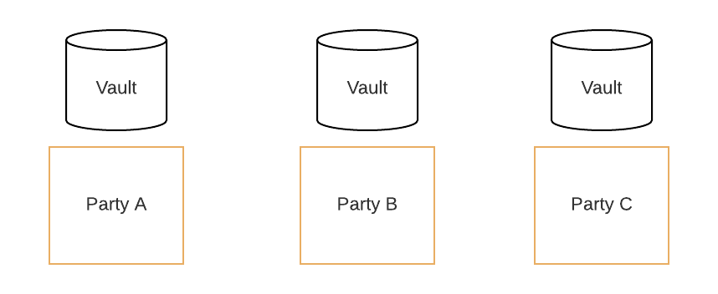
Step 0.3 – start nodes
Notes:
Run: build/nodes/runnodes

Slide 8
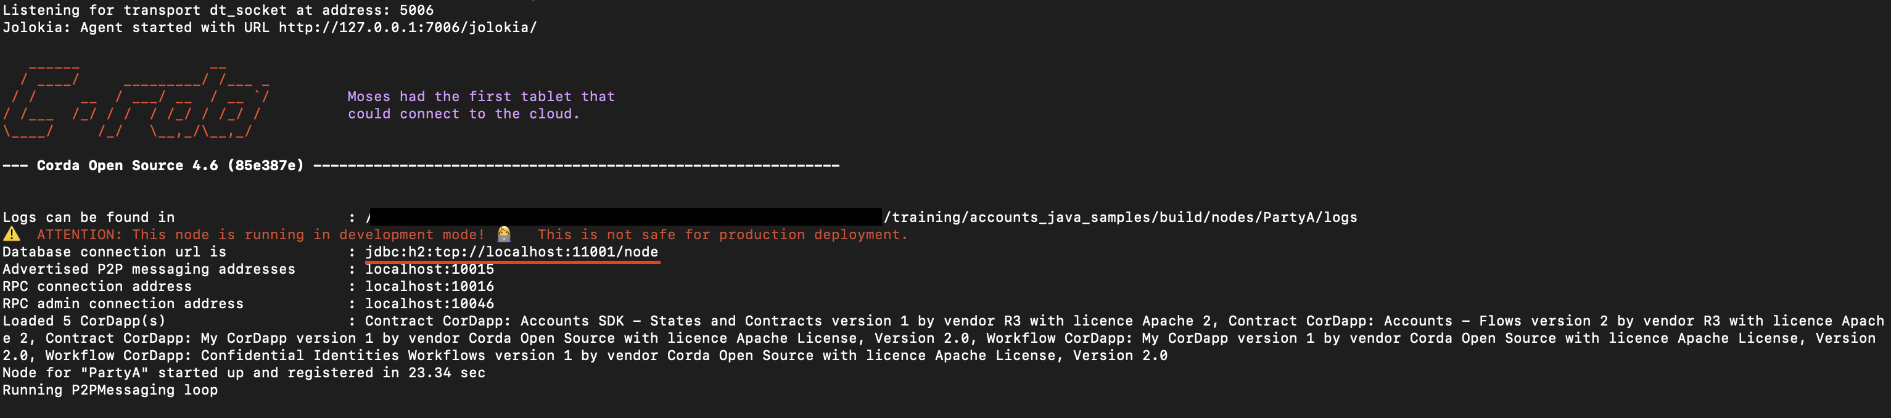
Step 0.3 – start the nodes
PartyA: jdbc:h2:tcp://localhost:11001/node
PartyB: jdbc:h2:tcp://localhost:11002/node
PartyC: jdbc:h2:tcp://localhost:11003/node
Notes:
Run: build/nodes/runnodes
Highlighted on the screenshot – connection string to database to put into JDBC URL

Slide 9
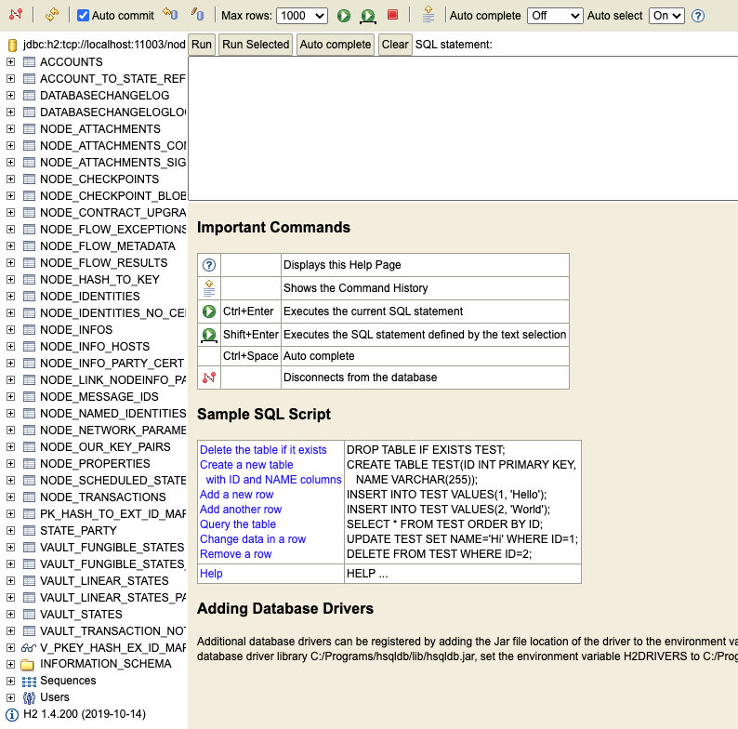
Step 0.4 – test database connection from the viewer
Notes:
Run: build/nodes/runnodes

Slide 10
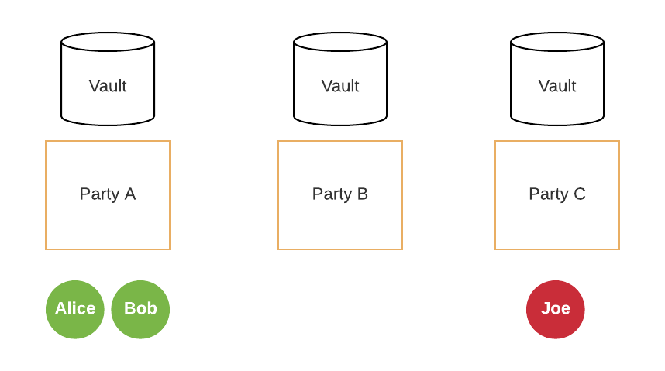
Step 1. Create the accounts

Slide 11
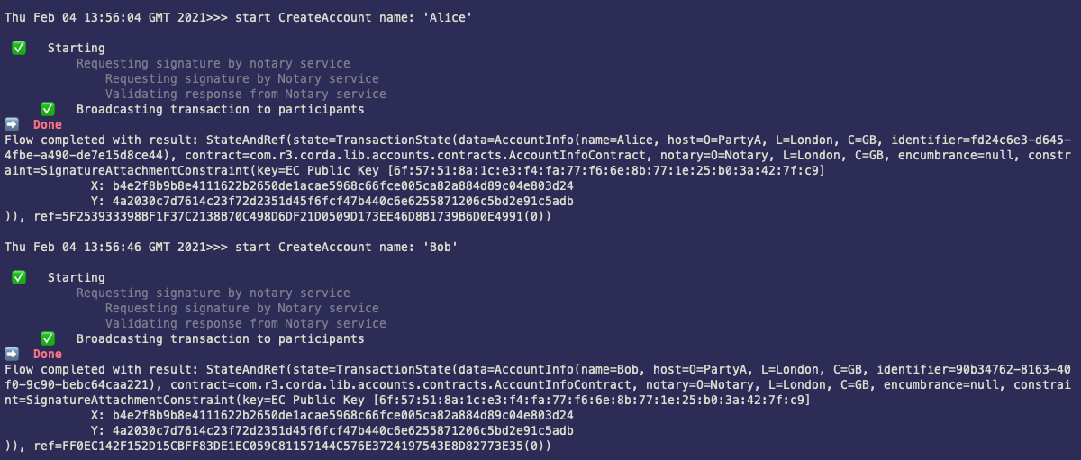
Step 1.1 Create the accounts – Party A
Notes:
start CreateAccount name: 'Alice’
start CreateAccount name: 'Bob'

Slide 12
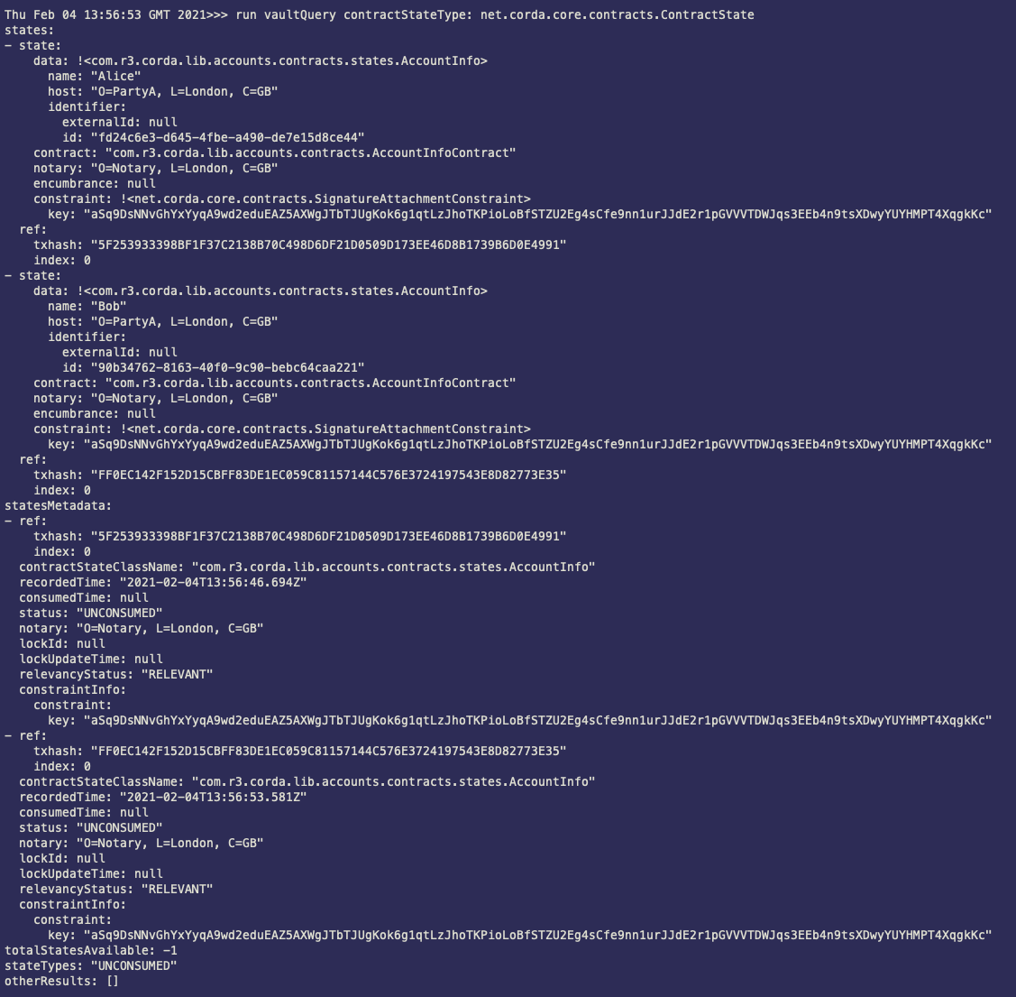
Step 1.2 Checking the vault - PartyA
Notes:
run vaultQuery contractStateType: net.corda.core.contracts.ContractState

Slide 13
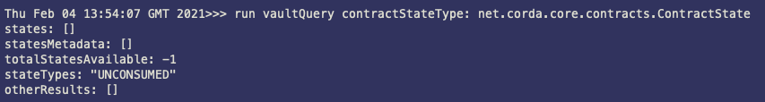
Step 1.3 Checking the vault – PartyB, PartyC
Notes:
run vaultQuery contractStateType: net.corda.core.contracts.ContractState

Slide 14
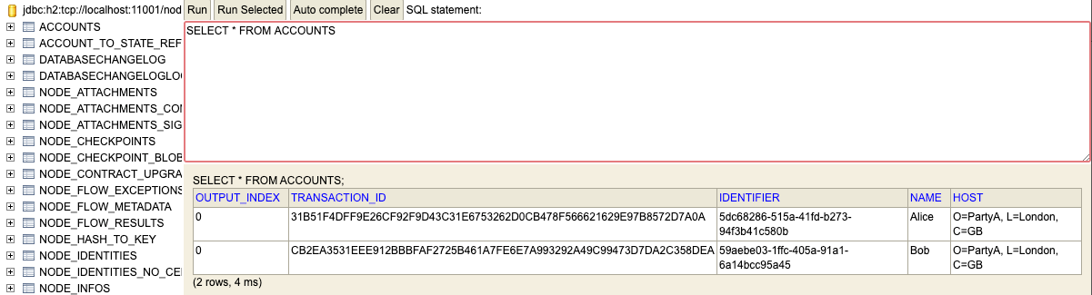
Step 1.4 Check the database on PartyA
Notes:
SELECT * FROM ACCOUNTS

Slide 15
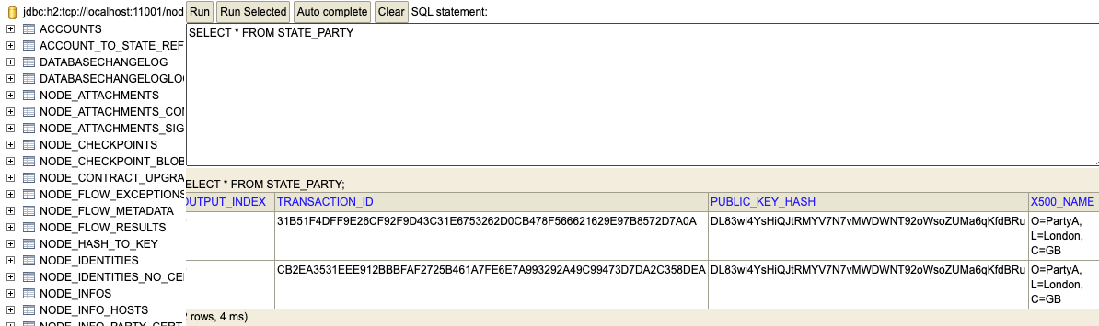
Step 1.4 Check the database on PartyA
Notes:
SELECT * FROM STATE_PARTY

Slide 16
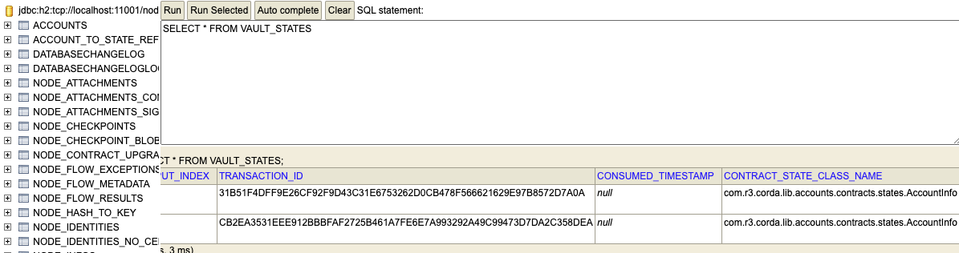
Step 1.4 Check the database on PartyA
Notes:
SELECT * FROM VAULT_STATES

Slide 17
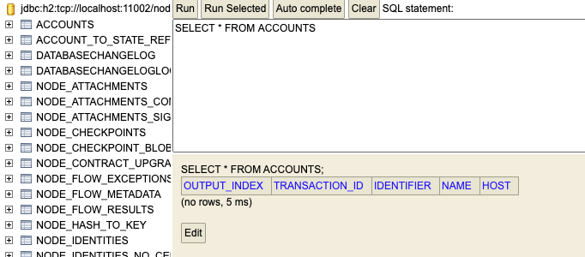
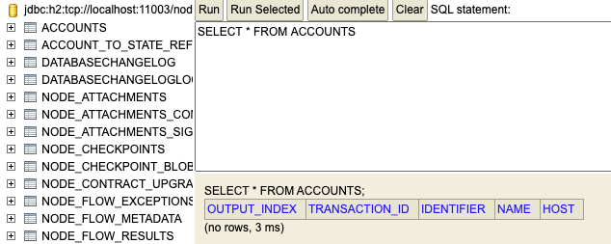
Step 1.5 Check the database on PartyB, PartyC
Notes:
SELECT * FROM VAULT_STATES

Slide 18
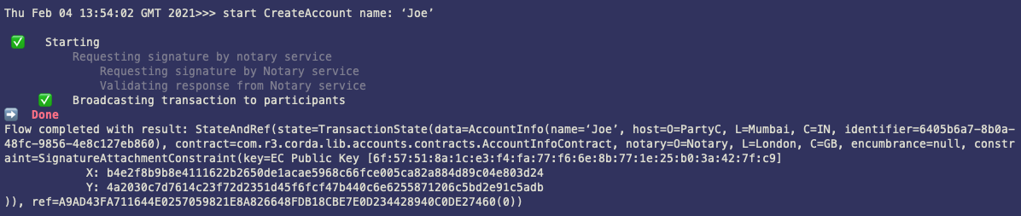
Step 1.6 Create the account – Party C
Notes:
start CreateAccount name: ‘Joe’

Slide 19
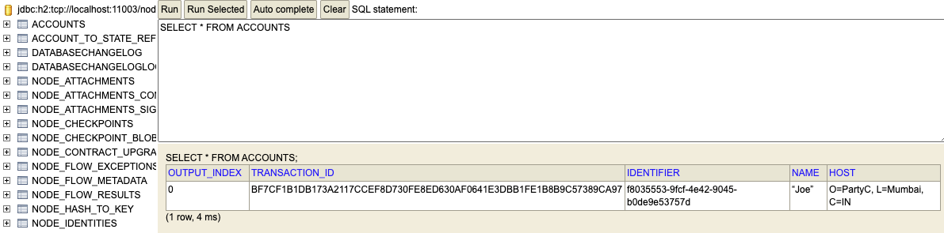
Step 1.7 Party C – checking the database
Notes:
SELECT * FROM ACCOUNTS

Slide 20
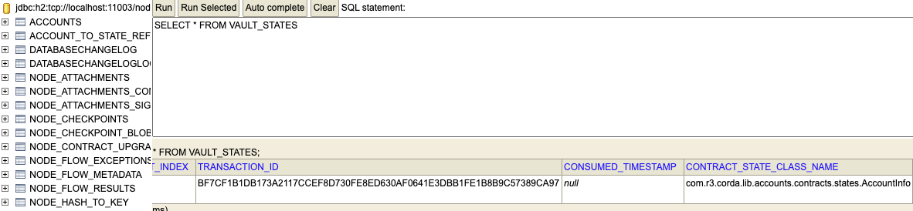
Step 1.7 Party C – checking the database
Notes:
SELECT * FROM VAULT_STATES

Slide 21
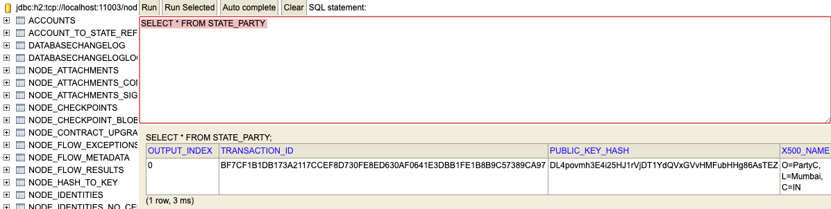
Step 1.7 Party C – checking the database
Notes:
SELECT * FROM STATE_PARTY

Slide 22
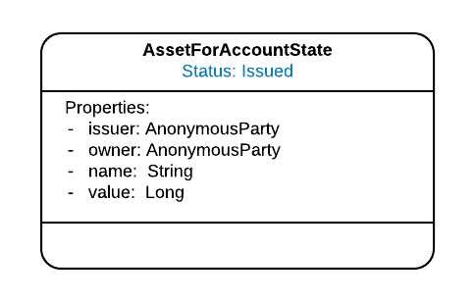
Step 2. Asset

Slide 23
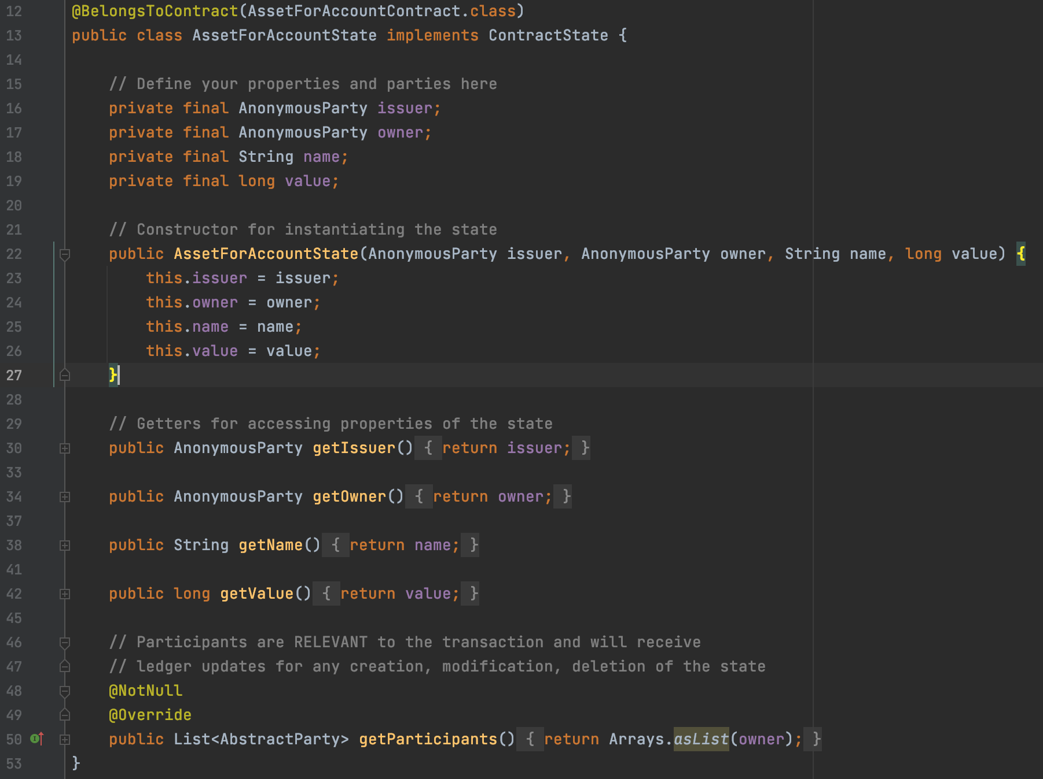
Step 2. Asset
Notes:
https://github.com/corda/accounts_java_samples/blob/tenancyfeb21/contracts/src/main/java/org/r3/contracts/AssetForAccountState.java

Slide 24
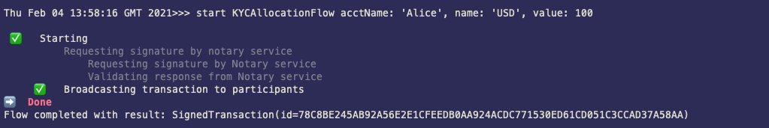
Step 2.1 Asset – Allocation for Alice on PartyA
Notes:
start KYCAllocationFlow acctName: 'Alice', name: 'USD', value: 100

Slide 25
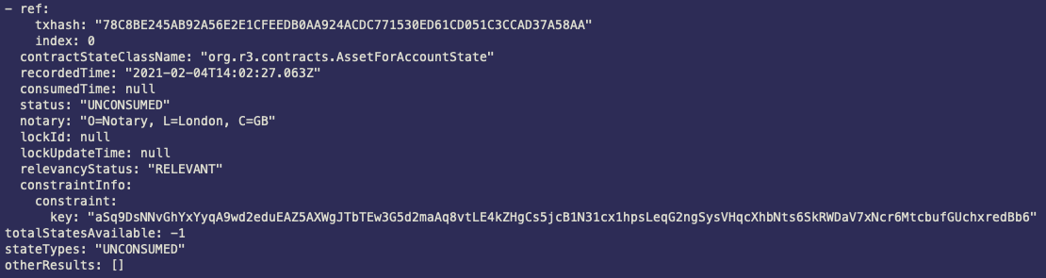
Step 2.2 Checking vault on PartyA
Notes:
run vaultQuery contractStateType: net.corda.core.contracts.ContractState

Slide 26
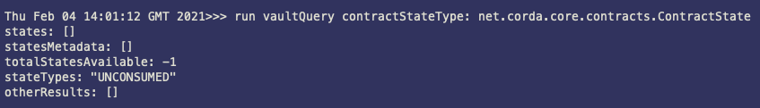
Step 2.3 Checking vault on PartyB
Notes:
run vaultQuery contractStateType: net.corda.core.contracts.ContractState

Slide 27
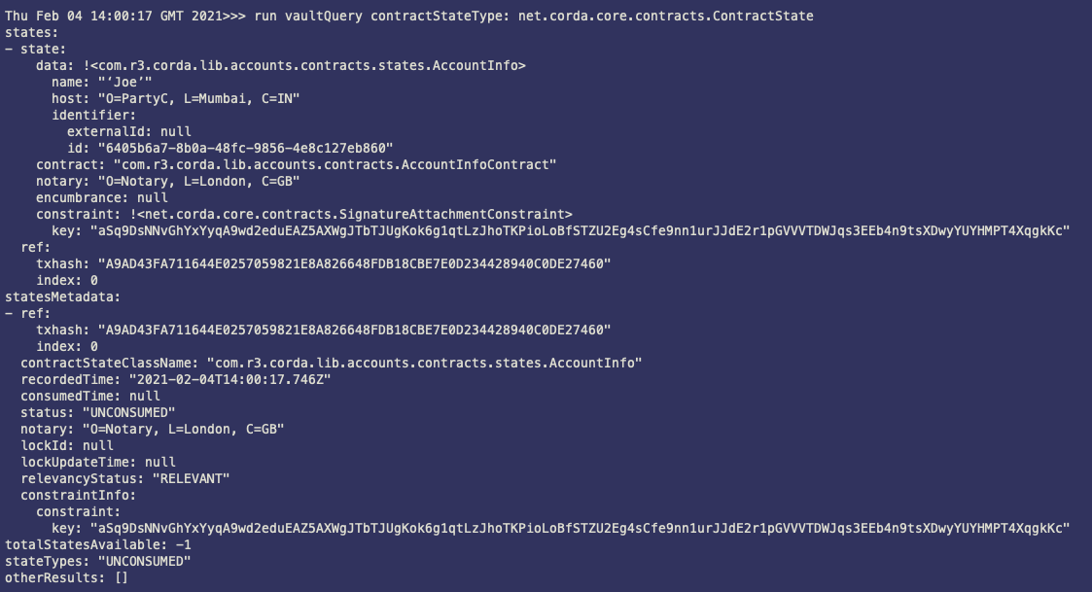
Step 2.4 Checking vault on PartyC
Notes:
run vaultQuery contractStateType: net.corda.core.contracts.ContractState

Slide 28
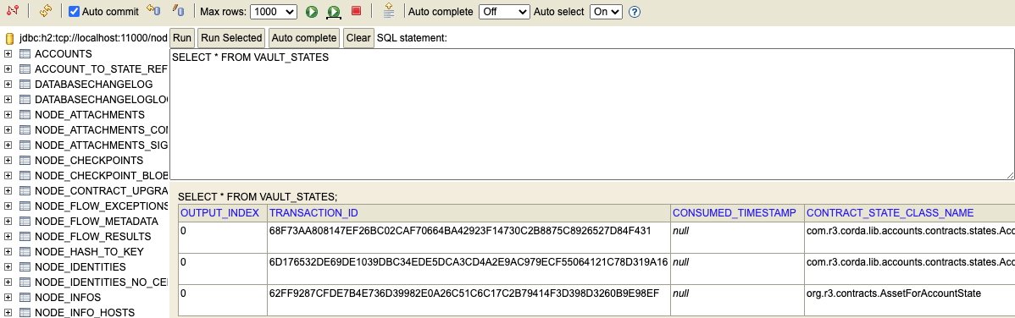
Step 2.5 Checking database on PartyA
Notes:
SELECT * FROM VAULT_STATES

Slide 29
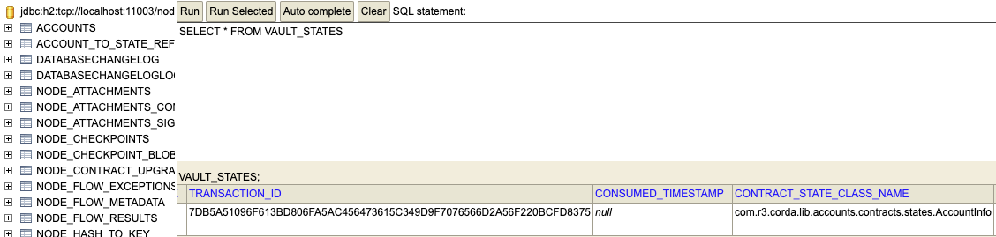
Step 2.5 Checking database on PartyC
Notes:
SELECT * FROM VAULT_STATES

Slide 30
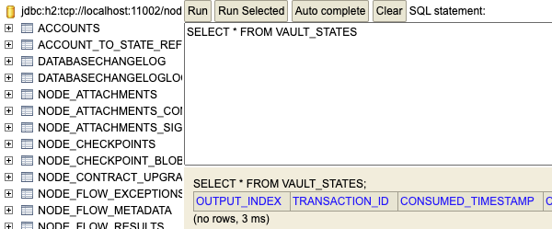
Step 2.5 Checking database on PartyB
Notes:
SELECT * FROM VAULT_STATES

Slide 31
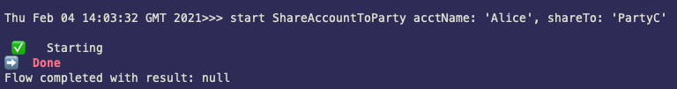
Step 3. Sharing Alice account info with PartyC
Notes:
start ShareAccountToParty acctName: 'Alice', shareTo: 'PartyC'

Slide 32
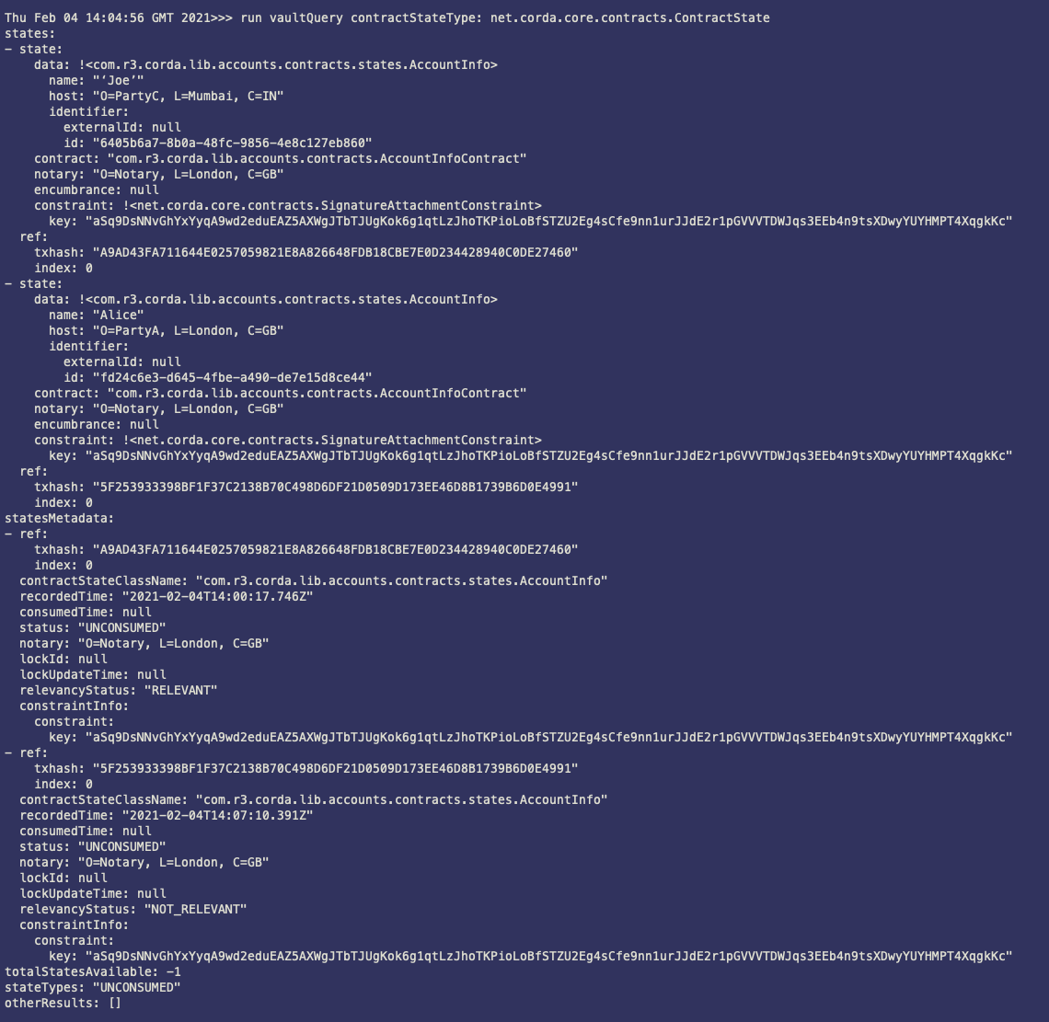
Step 3.1 Checking PartyC vault
Notes:
run vaultQuery contractStateType: net.corda.core.contracts.ContractState

Slide 33
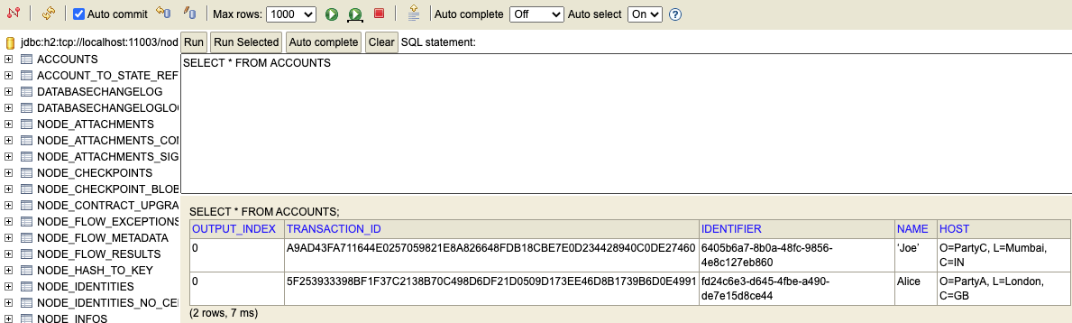
Step 3.2 Checking PartyC database
Notes:
SELECT * FROM ACCOUNTS

Slide 34
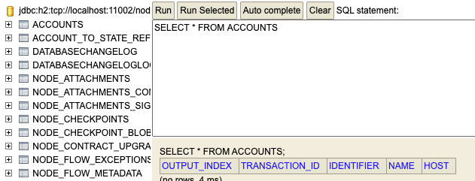
Step 3.3 Checking PartyB database
Notes:
SELECT * FROM ACCOUNTS

